Slide 2
develop understanding about basics of pipes and cisterns,
analyze various important facts and formulae relating to pipes and cisterns.

Slide 3
Pipes & Cisterns
To Fill/Emptying –Tank/Cistern
Inlet
Pipe – To Fill Tank/Cistern
Outlet
Pipe – Emptying Tank/Cistern

Slide 4
Pipes & Cisterns
Time taken to fill a cistern - Positive
Time taken to empty a cistern – Negative
Amount of Work Done (Filling/Emptying a Cistern)
– Unity

Slide 5
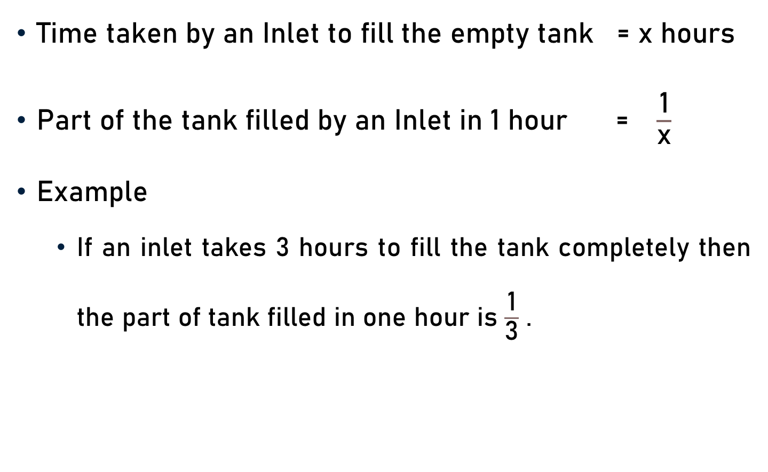
Inlet - Part of Tank Filled
Time taken by an Inlet to fill the empty tank = x hours
Part of the tank filled by an Inlet in 1 hour = $\frac{\text{1}}{\text{x}}$
Example
  If an inlet takes 3 hours to fill the tank completely then the part of tank filled in one hour is $\frac{\text{1}}{\text{3}}$ .

Slide 6
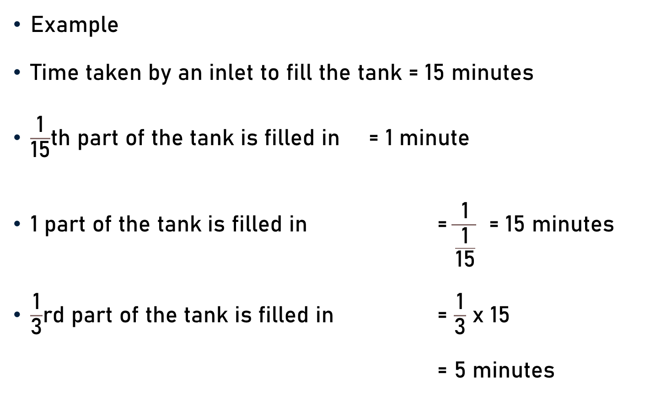
Inlet - Part of Tank Filled
Example
Time taken by an inlet to fill the tank = 15 minutes
$\frac{\text{1}}{\text{15}}$th part of the tank is filled in = 1 minute
1 part of the tank is filled in = $\frac{\text{1}}{\frac{\text{1}}{\text{15}}}$ = 15 minutes
$\frac{\text{1}}{\text{3}}$rd part of the tank is filled in = $\frac{\text{1}}{\text{3}}$ x 15
= 5 minutes
5

Slide 7
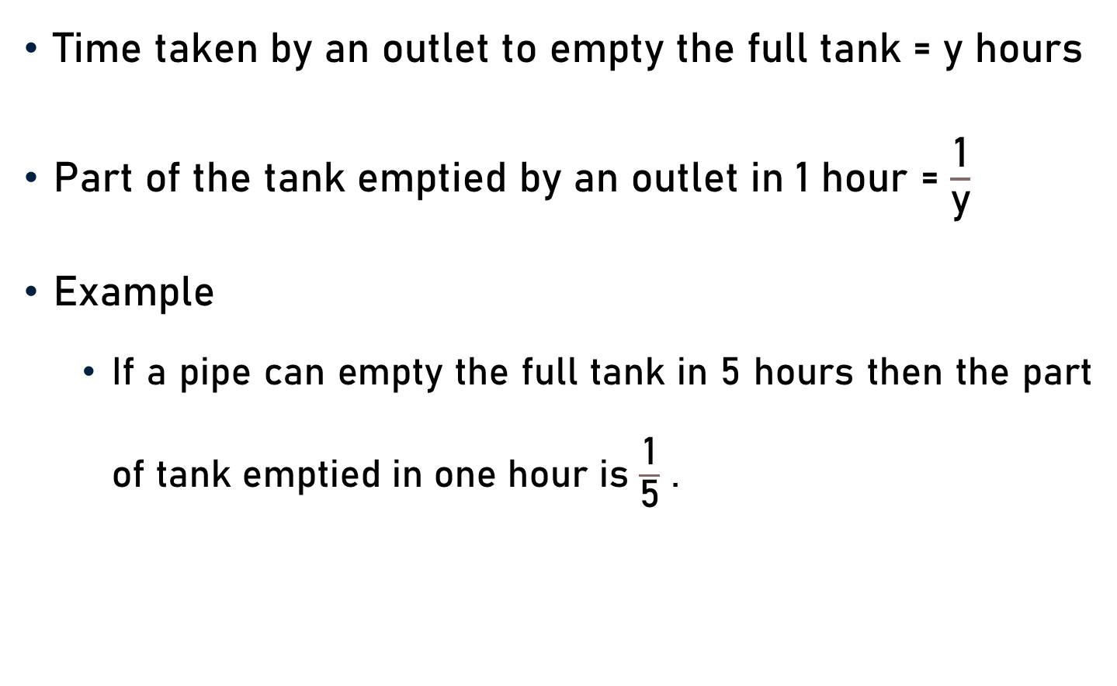
Outlet - Part of Tank Emptied
Time taken by an outlet to empty the full tank = y hours
Part of the tank emptied by an outlet in 1 hour = $\frac{\text{1}}{\text{y}}$
Example
  If a pipe can empty the full tank in 5 hours then the part of tank emptied in one hour is $\frac{\text{1}}{\text{5}}$ .

Slide 8
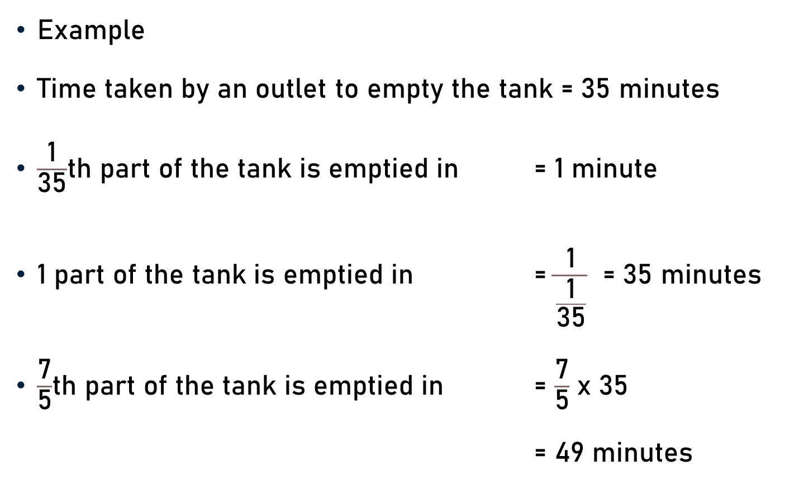
Outlet - Part of Tank Emptied
Example
Time taken by an outlet to empty the tank = 35 minutes
$\frac{\text{1}}{\text{3}\text{5}}$th part of the tank is emptied in = 1 minute
1 part of the tank is emptied in = $\frac{\text{1}}{\frac{\text{1}}{\text{3}\text{5}}}$ = 35 minutes
$\frac{\text{7}}{\text{5}}$th part of the tank is emptied in = $\frac{\text{7}}{\text{5}}$ x 35
= 49 minutes
7

Slide 9
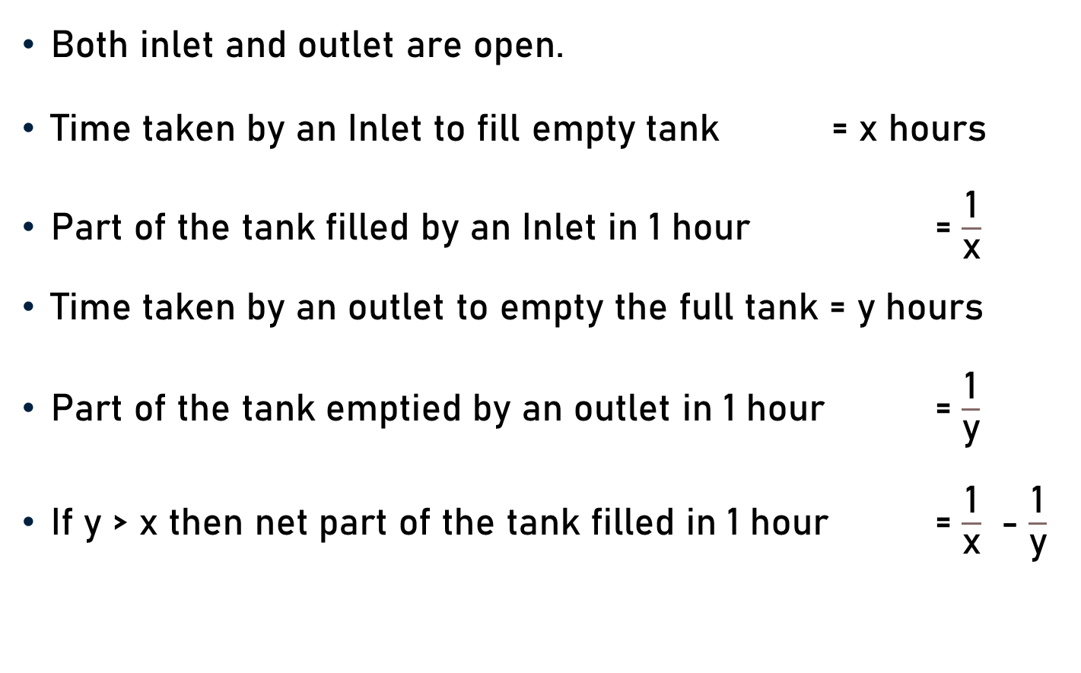
Inlet & Outlet – Net Part of Tank Filled
Both inlet and outlet are open.
Time taken by an Inlet to fill empty tank = x hours
Part of the tank filled by an Inlet in 1 hour = $\frac{\text{1}}{\text{x}}$
Time taken by an outlet to empty the full tank = y hours
Part of the tank emptied by an outlet in 1 hour = $\frac{\text{1}}{\text{y}}$
If y > x then net part of the tank filled in 1 hour = $\frac{\text{1}}{\text{x}}$ - $\frac{\text{1}}{\text{y}}$

Slide 10
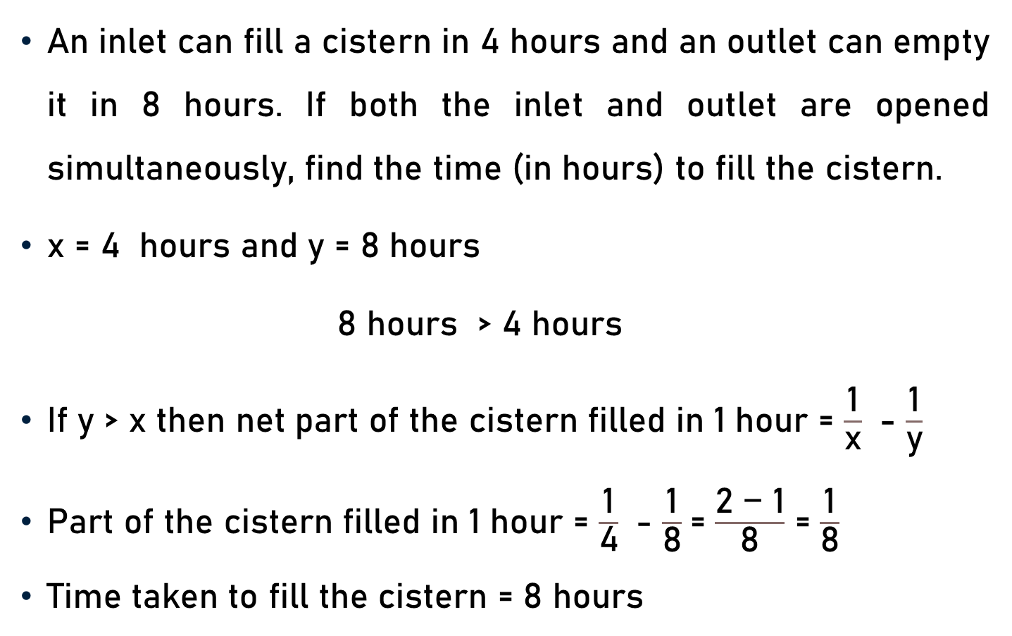
Inlet & Outlet – Net Part of Tank Filled
An inlet can fill a cistern in 4 hours and an outlet can empty it in 8 hours. If both the inlet and outlet are opened simultaneously, find the time (in hours) to fill the cistern.
x = 4 hours and y = 8 hours
8 hours > 4 hours
If y > x then net part of the cistern filled in 1 hour = $\frac{\text{1}}{\text{x}}$ - $\frac{\text{1}}{\text{y}}$
Part of the cistern filled in 1 hour = $\frac{\text{1}}{\text{4}}$ - $\frac{\text{1}}{\text{8}}$= $\frac{\text{2 − 1}}{\text{8}}$ = $\frac{\text{1}}{\text{8}}$
Time taken to fill the cistern = 8 hours

Slide 11
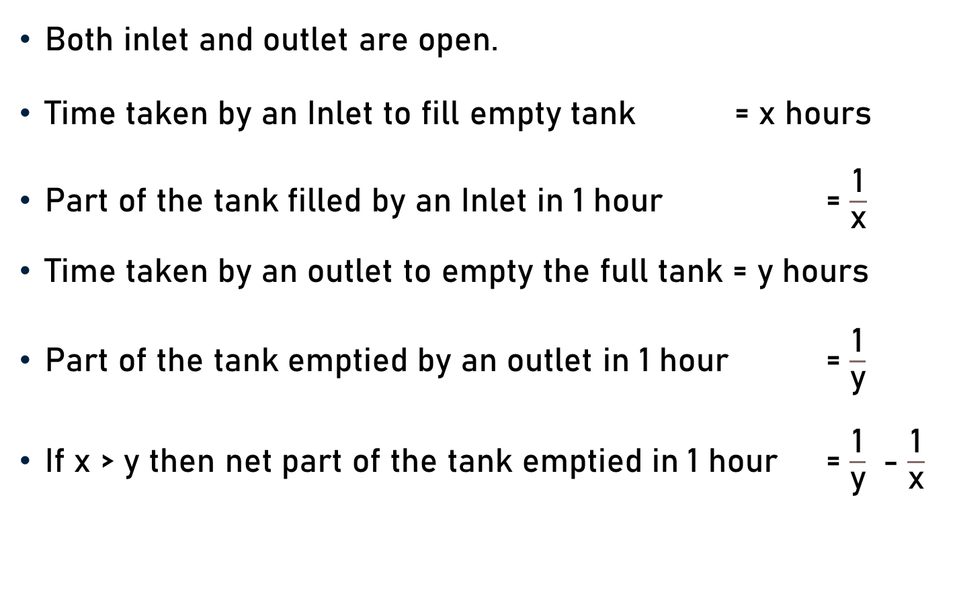
Inlet & Outlet – Net Part of Tank Emptied
Both inlet and outlet are open.
Time taken by an Inlet to fill empty tank = x hours
Part of the tank filled by an Inlet in 1 hour = $\frac{\text{1}}{\text{x}}$
Time taken by an outlet to empty the full tank = y hours
Part of the tank emptied by an outlet in 1 hour = $\frac{\text{1}}{\text{y}}$
If x > y then net part of the tank emptied in 1 hour = $\frac{\text{1}}{\text{y}}$ - $\frac{\text{1}}{\text{x}}$

Slide 12
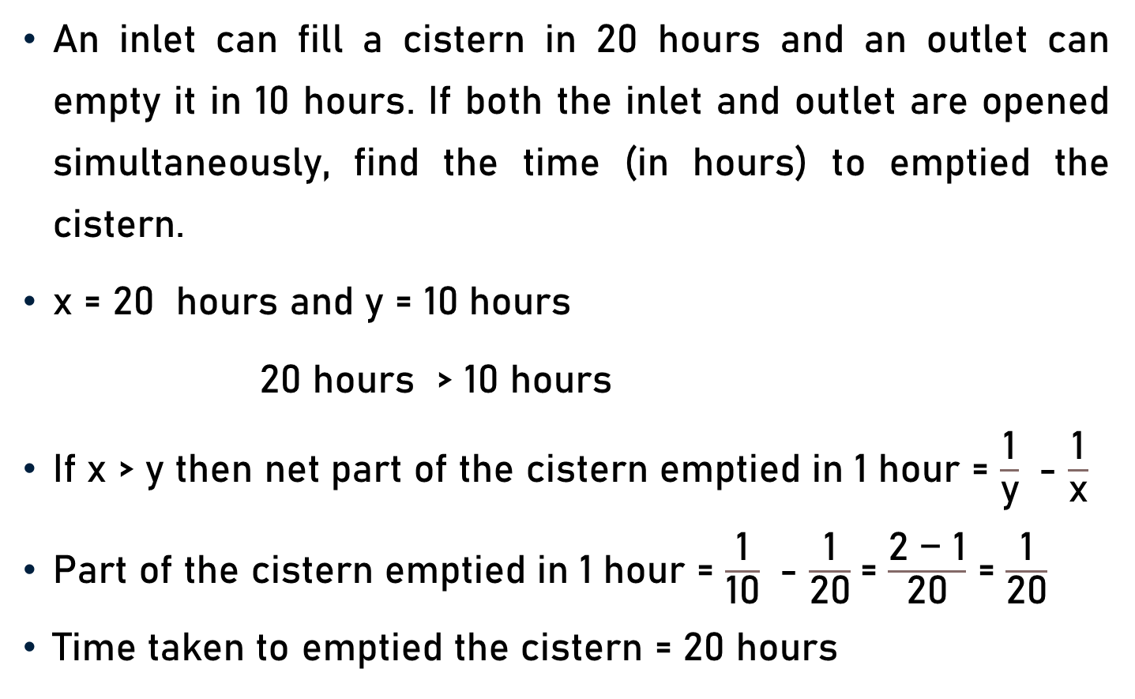
Inlet & Outlet – Net Part of Tank Emptied
An inlet can fill a cistern in 20 hours and an outlet can empty it in 10 hours. If both the inlet and outlet are opened simultaneously, find the time (in hours) to emptied the cistern.
x = 20 hours and y = 10 hours
20 hours > 10 hours
If x > y then net part of the cistern emptied in 1 hour = $\frac{\text{1}}{\text{y}}$ - $\frac{\text{1}}{\text{x}}$
Part of the cistern emptied in 1 hour = $\frac{\text{1}}{\text{10}}$ - $\frac{\text{1}}{\text{20}}$= $\frac{\text{2 − 1}}{\text{20}}$ = $\frac{\text{1}}{\text{20}}$
Time taken to emptied the cistern = 20 hours

Slide 13
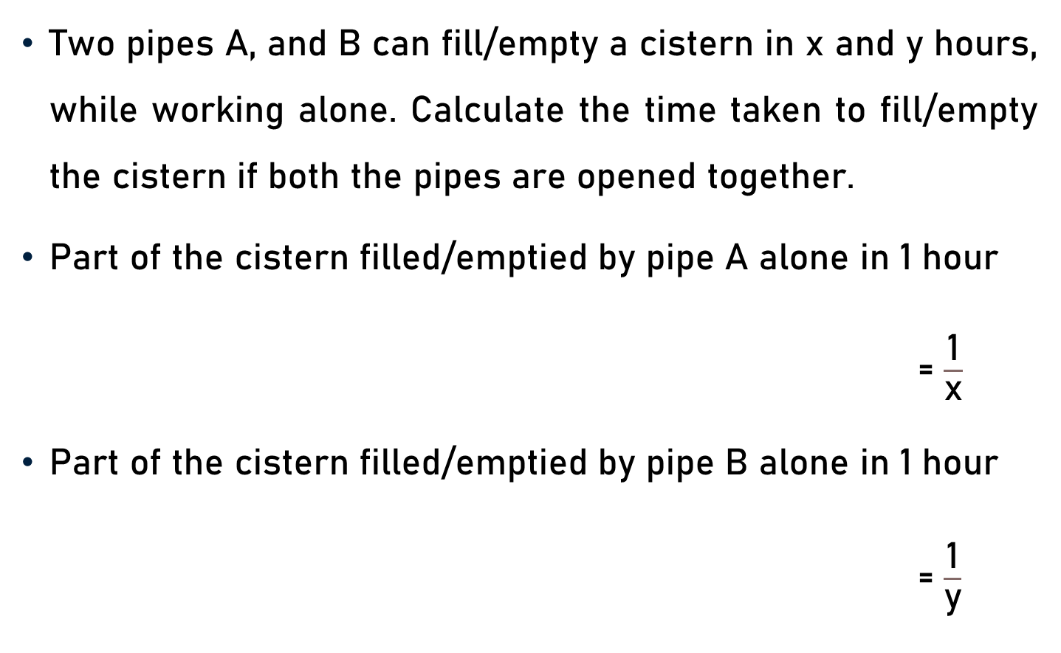
Inlet & Outlet – Time Taken to Fill/Empty Cistern
Two pipes A, and B can fill/empty a cistern in x and y hours, while working alone. Calculate the time taken to fill/empty the cistern if both the pipes are opened together.
Part of the cistern filled/emptied by pipe A alone in 1 hour
= $\frac{\text{1}}{\text{x}}$
Part of the cistern filled/emptied by pipe B alone in 1 hour
= $\frac{\text{1}}{\text{y}}$

Slide 14
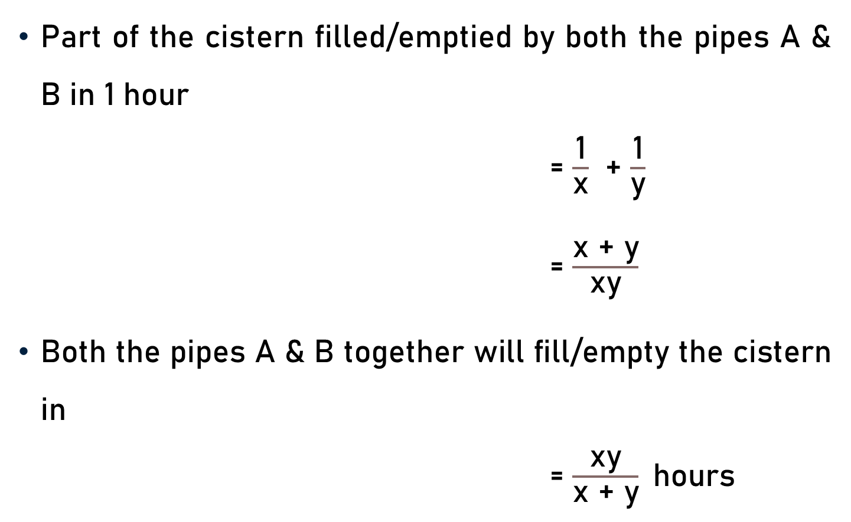
Inlet & Outlet – Time Taken to Fill/Empty Cistern
Part of the cistern filled/emptied by both the pipes A & B in 1 hour
= $\frac{\text{1}}{\text{x}}$ + $\frac{\text{1}}{\text{y}}$
= $\frac{\text{x}\text{ + }\text{y}}{\text{xy}}$
Both the pipes A & B together will fill/empty the cistern in
= $\frac{\text{xy}}{\text{x}\text{ + }\text{y}}$hours

Slide 15
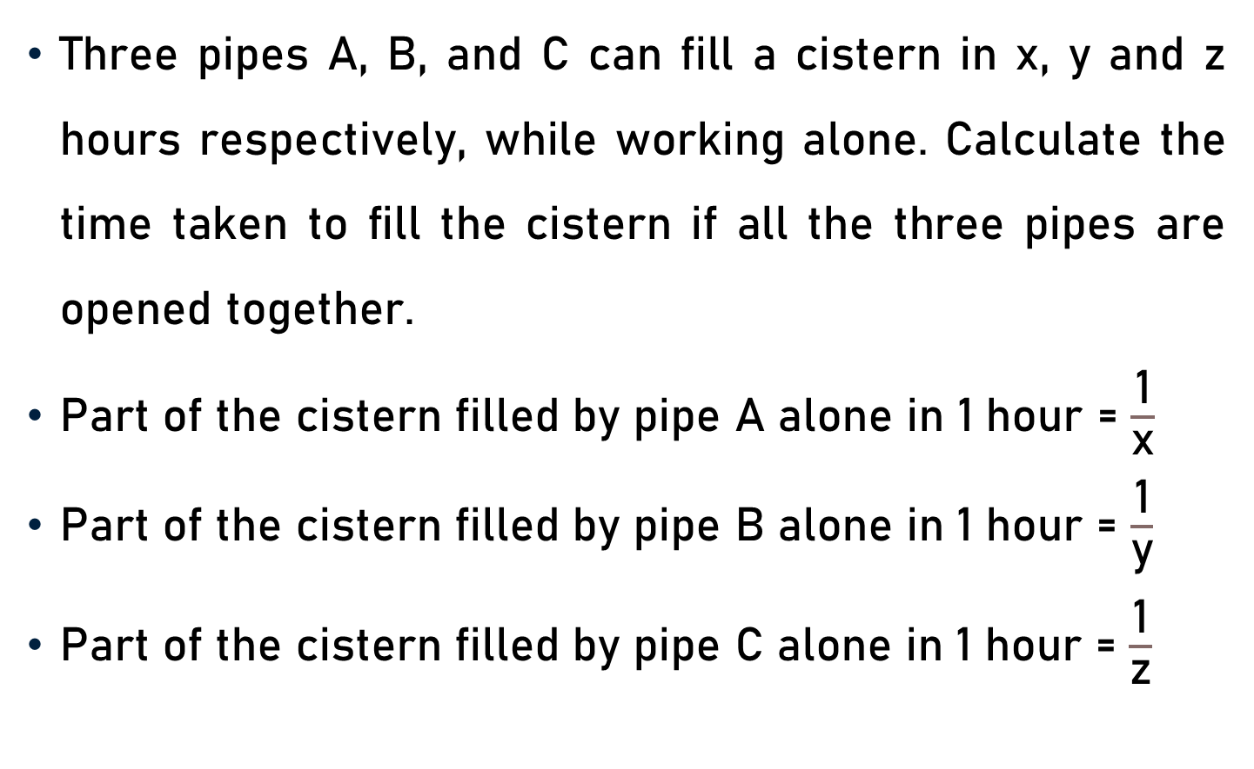
Inlet & Outlet – Time Taken to Fill Cistern
Three pipes A, B, and C can fill a cistern in x, y and z hours respectively, while working alone. Calculate the time taken to fill the cistern if all the three pipes are opened together.
Part of the cistern filled by pipe A alone in 1 hour = $\frac{\text{1}}{\text{x}}$
Part of the cistern filled by pipe B alone in 1 hour = $\frac{\text{1}}{\text{y}}$
Part of the cistern filled by pipe C alone in 1 hour = $\frac{\text{1}}{\text{z}}$

Slide 16
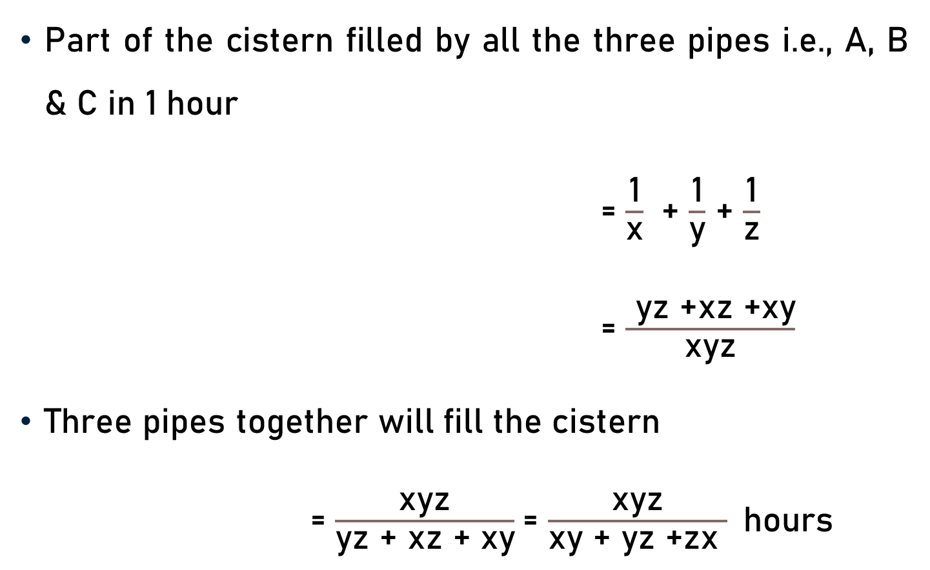
Inlet & Outlet – Time Taken to Fill Cistern
Part of the cistern filled by all the three pipes i.e., A, B & C in 1 hour
= $\frac{\text{1}}{\text{x}}$ + $\frac{\text{1}}{\text{y}}$ + $\frac{\text{1}}{\text{z}}$
= $\frac{ \text{yz}\text{ +}\text{xz}\text{ +}\text{xy}}{\text{x}\text{yz}}$
Three pipes together will fill the cistern
= $\frac{\text{xyz}}{\text{yz}\text{ +} \text{xz}\text{ +} \text{xy}}$= $\frac{\text{xyz}}{\text{xy}\text{ + }\text{yz}\text{ +}\text{zx} }$hours

Slide 17
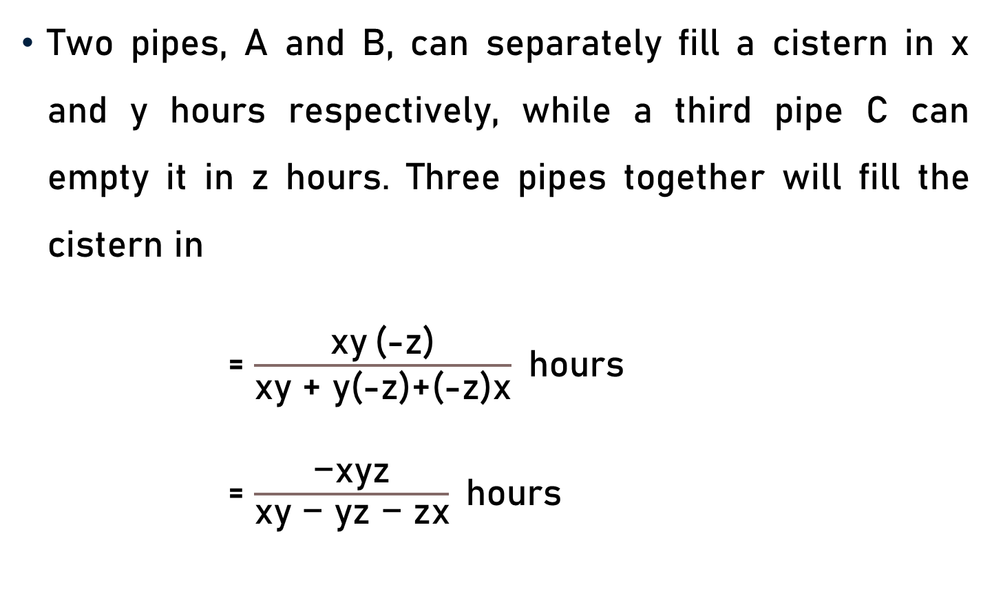
Inlet & Outlet – Time Taken to Fill Cistern
Two pipes, A and B, can separately fill a cistern in x and y hours respectively, while a third pipe C can empty it in z hours. Three pipes together will fill the cistern in
= $\frac{\text{xy} \text{(}\text{−}\text{z}\text{)}}{\text{xy} \text{+} \text{y}\text{(}\text{−}\text{z}\text{)}\text{+}\text{(}\text{−}\text{z}\text{)}\text{x}}$hours
= $\frac{\text{−}\text{xyz}}{\text{xy}\text{ − }\text{yz} \text{− }\text{zx}}$hours

Slide 18
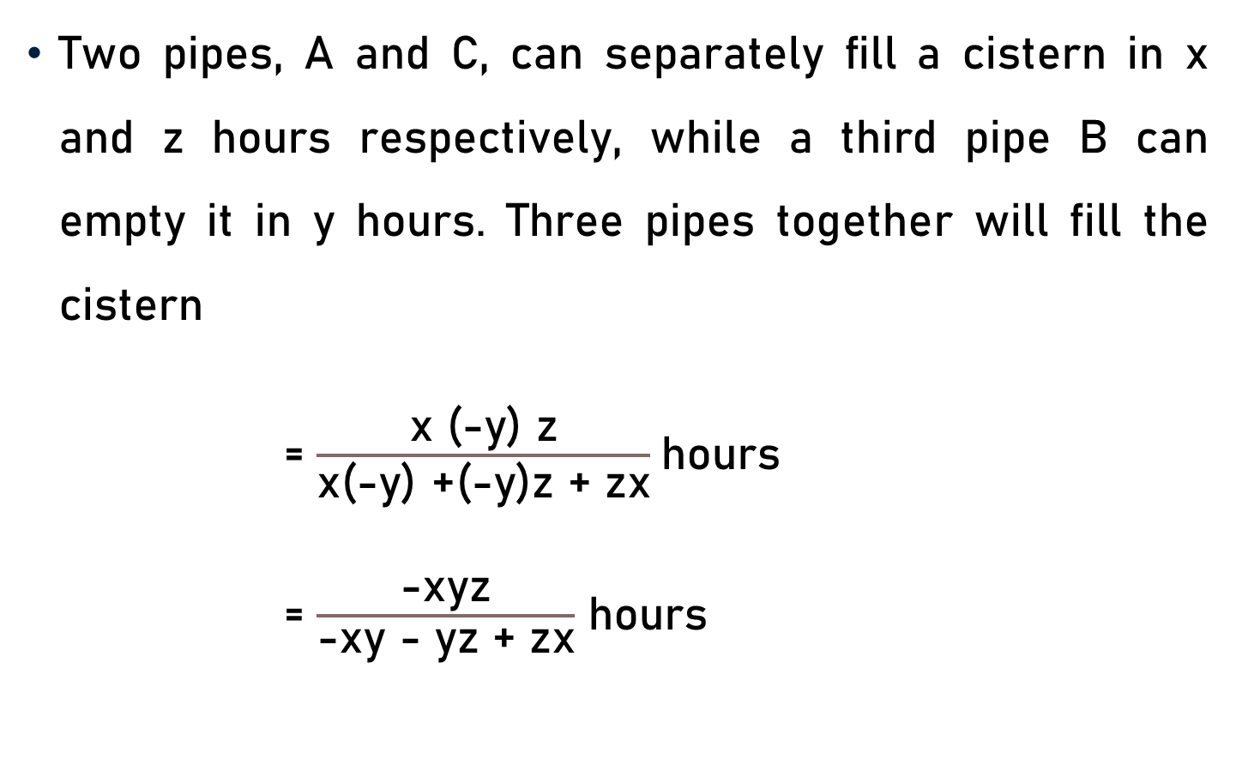
Inlet & Outlet – Time Taken to Fill Cistern
Two pipes, A and C, can separately fill a cistern in x and z hours respectively, while a third pipe B can empty it in y hours. Three pipes together will fill the cistern
= $\frac{\text{x}\text{ (−}\text{y}\text{) }\text{z}}{\text{x}\text{(}\text{−}\text{y}\text{)}\text{ +}\text{(}\text{−}\text{y}\text{)}\text{z} \text{+} \text{zx}}$hours
= $\frac{\text{−}\text{xyz}}{\text{−}\text{xy} \text{−} \text{yz} \text{+} \text{zx}}$ hours

Slide 19
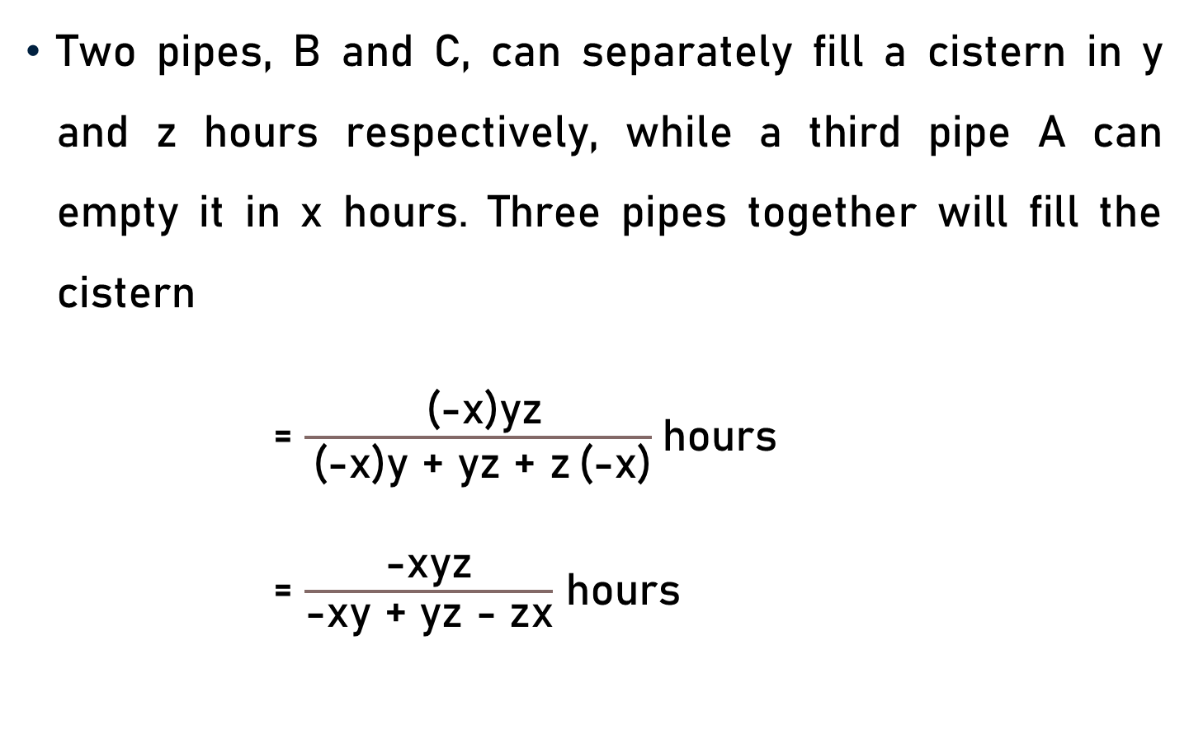
Inlet & Outlet – Time Taken to Fill Cistern
Two pipes, B and C, can separately fill a cistern in y and z hours respectively, while a third pipe A can empty it in x hours. Three pipes together will fill the cistern
= $\frac{\text{ (}\text{−}\text{x}\text{)}\text{yz}}{ \text{(}\text{−}\text{x}\text{)}\text{y} \text{+} \text{yz} \text{+ }\text{z} \text{(}\text{−}\text{x}\text{)}}$hours
= $\frac{\text{−}\text{xyz}}{\text{−}\text{xy} \text{+} \text{yz} \text{−} \text{zx}}$ hours

Slide 20
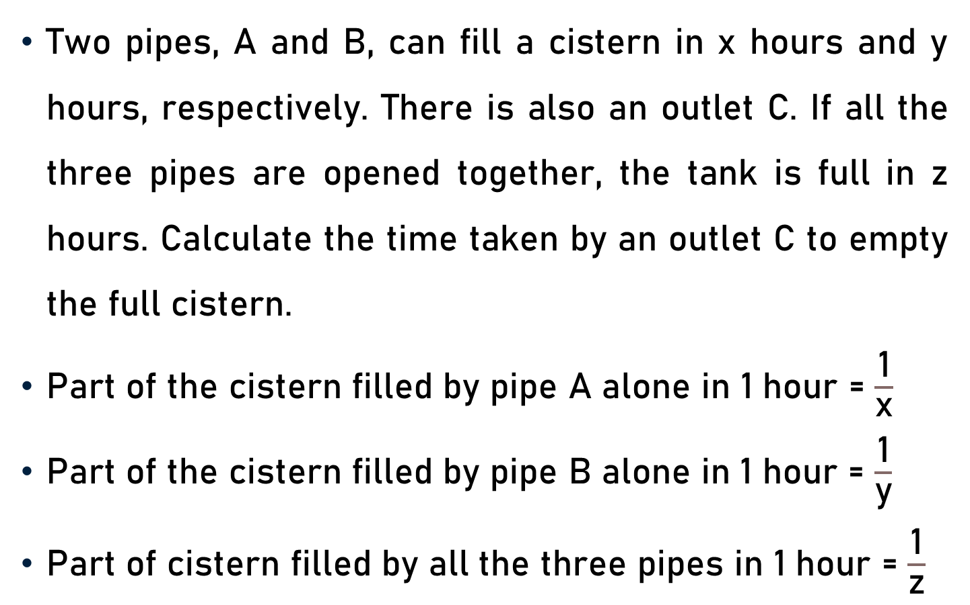
Inlet & Outlet – Time Taken to Empty Cistern
Two pipes, A and B, can fill a cistern in x hours and y hours, respectively. There is also an outlet C. If all the three pipes are opened together, the tank is full in z hours. Calculate the time taken by an outlet C to empty the full cistern.
Part of the cistern filled by pipe A alone in 1 hour = $\frac{\text{1}}{\text{x}}$
Part of the cistern filled by pipe B alone in 1 hour = $\frac{\text{1}}{\text{y}}$
Part of cistern filled by all the three pipes in 1 hour = $\frac{\text{1}}{\text{z}}$

Slide 21
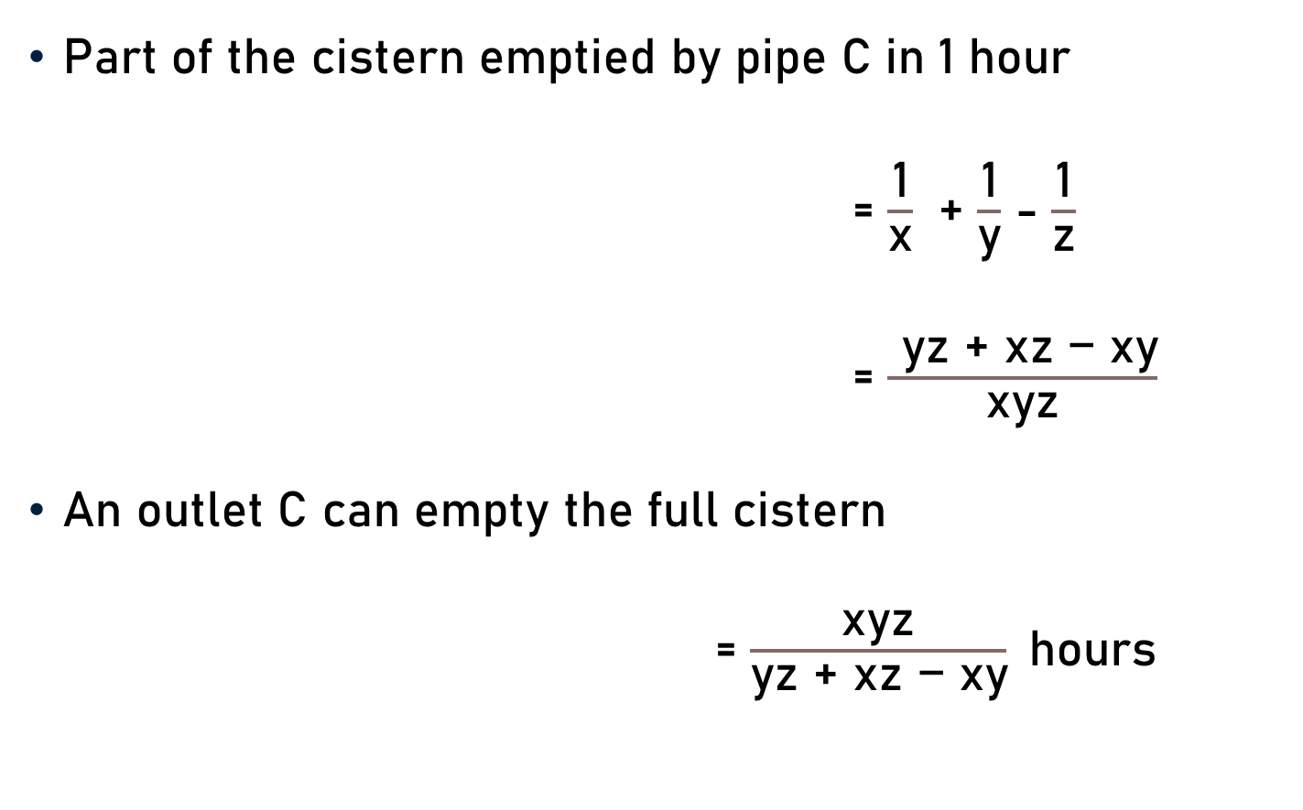
Inlet & Outlet – Time Taken to Empty Cistern
Part of the cistern emptied by pipe C in 1 hour
= $\frac{\text{1}}{\text{x}}$ + $\frac{\text{1}}{\text{y}}$ - $\frac{\text{1}}{\text{z}}$
= $\frac{ \text{yz}\text{ + }\text{x}\text{z}\text{ − }\text{xy}}{\text{x}\text{yz}}$
An outlet C can empty the full cistern
= $\frac{\text{xyz}}{\text{yz}\text{ + }\text{xz}\text{ − }\text{xy}}$hours

Slide 22
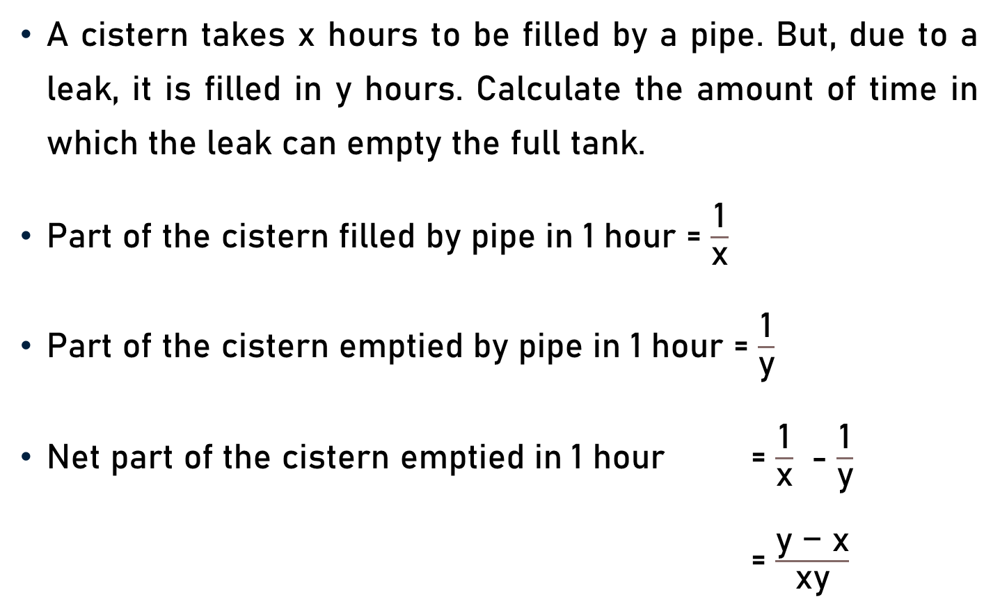
Inlet & Outlet – Time Taken to Empty Cistern
A cistern takes x hours to be filled by a pipe. But, due to a leak, it is filled in y hours. Calculate the amount of time in which the leak can empty the full tank.
Part of the cistern filled by pipe in 1 hour = $\frac{\text{1}}{\text{x}}$
Part of the cistern emptied by pipe in 1 hour = $\frac{\text{1}}{\text{y}}$
Net part of the cistern emptied in 1 hour = $\frac{\text{1}}{\text{x}}$ - $\frac{\text{1}}{\text{y}}$
= $\frac{\text{y}\text{ − }\text{x}}{\text{x}\text{y}}$

Slide 23

Inlet & Outlet – Time Taken to Empty Cistern
Net part of the cistern emptied in 1 hour = $\frac{\text{1}}{\text{x}}$ - $\frac{\text{1}}{\text{y}}$
= $\frac{\text{y}\text{ − }\text{x}}{\text{x}\text{y}}$
Amount of time in which the leak can empty the full tank
= $\frac{\text{x}\text{y}}{\text{y}\text{ − }\text{x}}$

Slide 24
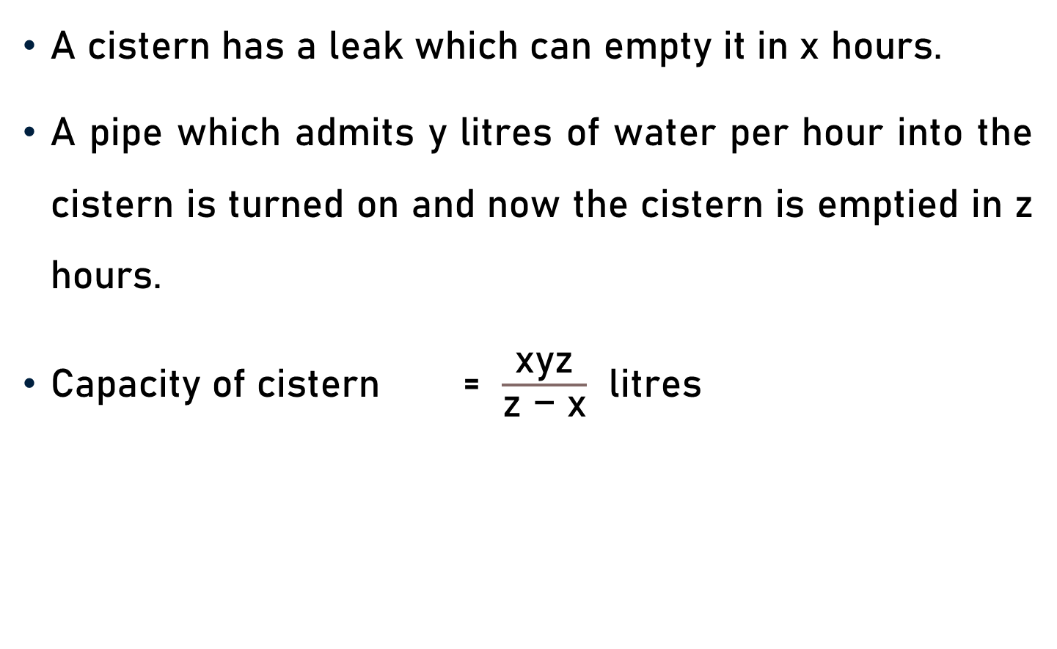
Inlet & Outlet – Capacity of Cistern
A cistern has a leak which can empty it in x hours.
A pipe which admits y litres of water per hour into the cistern is turned on and now the cistern is emptied in z hours.
Capacity of cistern = $\frac{\text{x}\text{y}\text{z}}{\text{z}\text{ − }\text{x}}$ litres

Slide 25
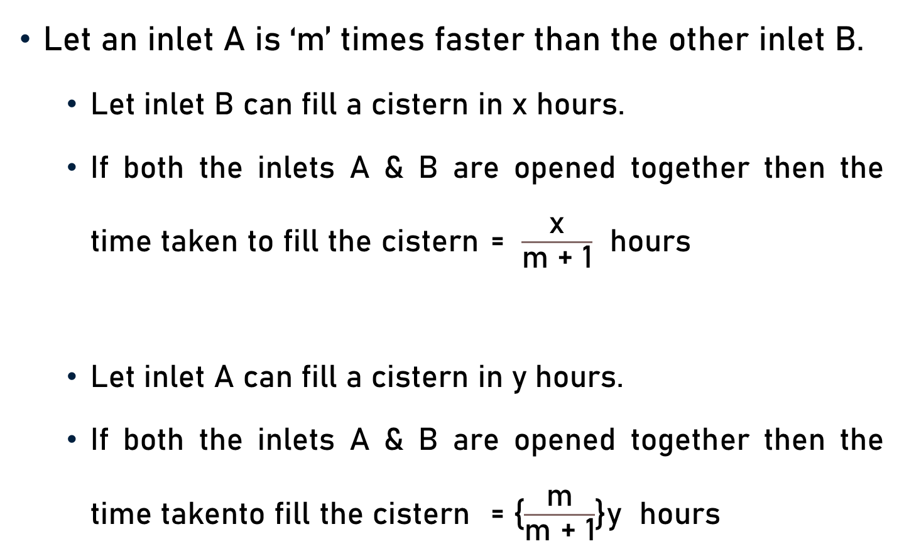
Inlet – Time Taken to Fill Cistern
Let an inlet A is ‘m’ times faster than the other inlet B.
  Let inlet B can fill a cistern in x hours.
  If both the inlets A & B are opened together then the time taken to fill the cistern = $\frac{\text{x}}{\text{m}\text{ + 1}}$ hours
  Let inlet A can fill a cistern in y hours.
  If both the inlets A & B are opened together then the time takento fill the cistern = {$\frac{\text{m}}{\text{m}\text{ + 1}}$}y hours

Slide 26
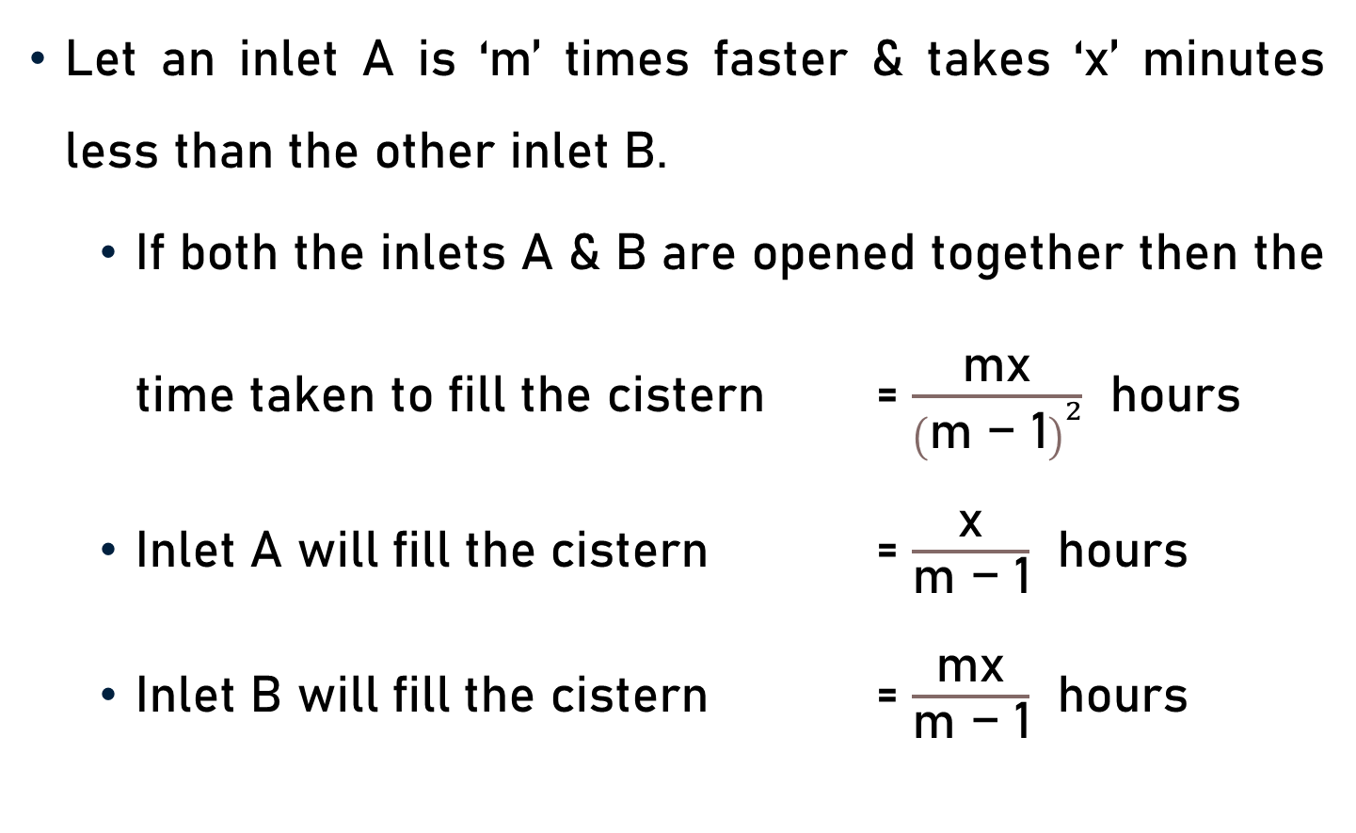
Inlet – Time Taken to Fill Cistern
Let an inlet A is ‘m’ times faster & takes ‘x’ minutes less than the other inlet B.
  If both the inlets A & B are opened together then the time taken to fill the cistern = $\frac{\text{m}\text{x}}{{\left(\text{m}\text{ − 1}\right)}^{2}}$ hours
  Inlet A will fill the cistern = $\frac{\text{x}}{\text{m}\text{ − 1}}$ hours
  Inlet B will fill the cistern = $\frac{\text{mx}}{\text{m}\text{ − 1}}$ hours

Slide 27
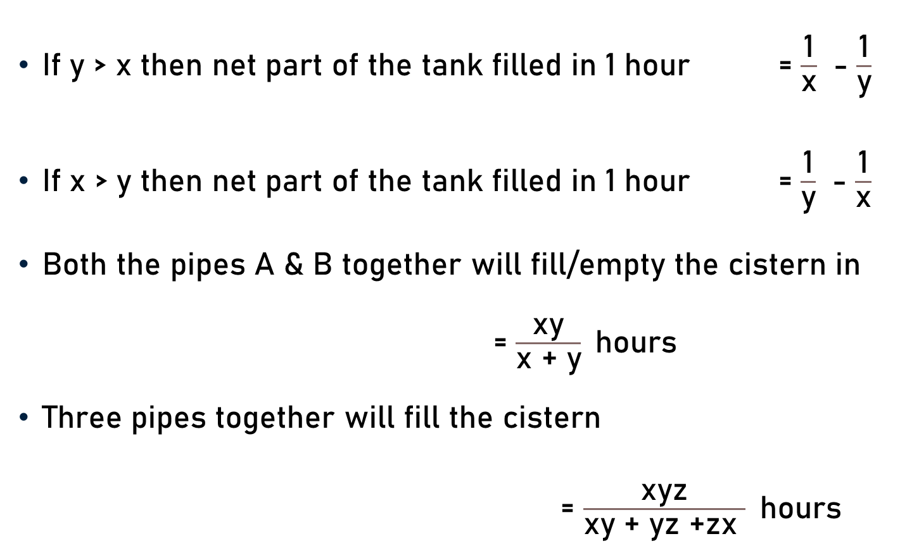
Conclusion
If y > x then net part of the tank filled in 1 hour = $\frac{\text{1}}{\text{x}}$ - $\frac{\text{1}}{\text{y}}$
If x > y then net part of the tank filled in 1 hour = $\frac{\text{1}}{\text{y}}$ - $\frac{\text{1}}{\text{x}}$
Both the pipes A & B together will fill/empty the cistern in = $\frac{\text{xy}}{\text{x}\text{ + }\text{y}}$hours
Three pipes together will fill the cistern
= $\frac{\text{xyz}}{\text{xy}\text{ + }\text{yz}\text{ +}\text{zx} }$hours

Slide 28

Conclusion
Three pipes together will fill the cistern in
  $\frac{\text{−}\text{xyz}}{\text{xy}\text{ − }\text{yz} \text{− }\text{zx}}$hours
  $\frac{\text{−}\text{xyz}}{\text{−}\text{xy}\text{ − }\text{yz} \text{+ }\text{zx}}$ hours
  $\frac{\text{−}\text{xyz}}{\text{−}\text{xy}\text{ + }\text{yz} \text{− }\text{zx}}$ hours

Slide 29
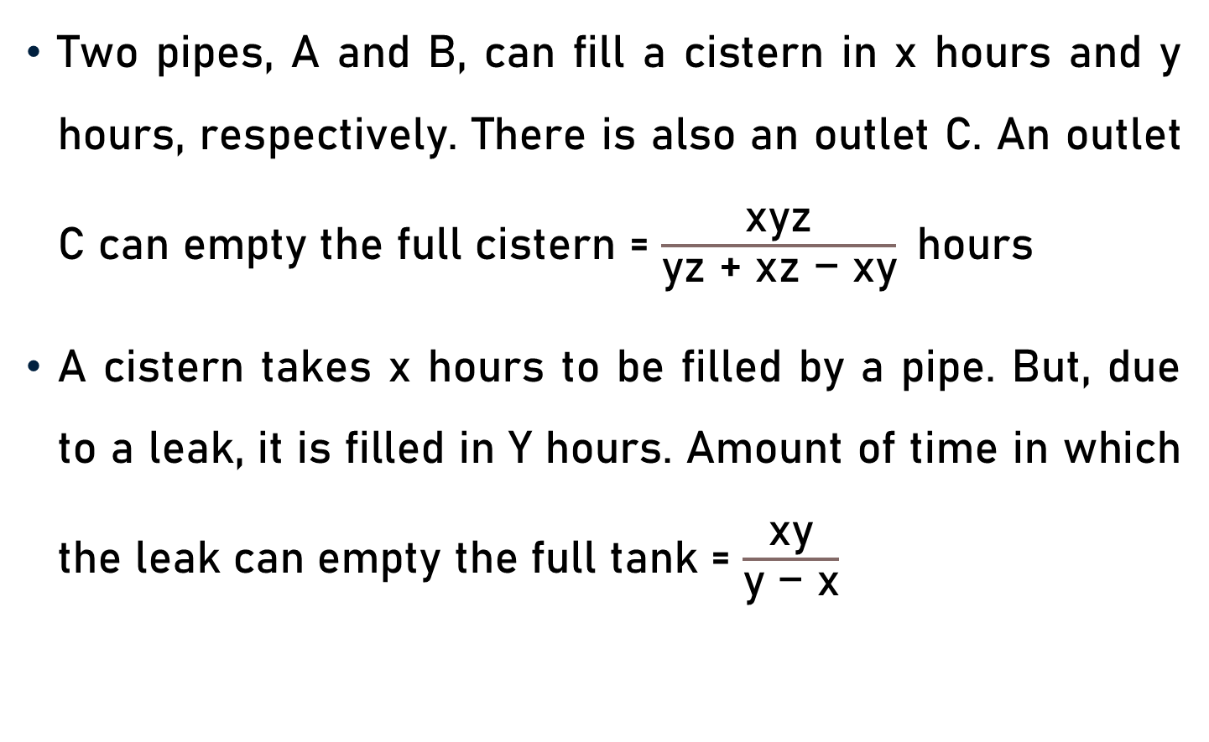
Conclusion
Two pipes, A and B, can fill a cistern in x hours and y hours, respectively. There is also an outlet C. An outlet C can empty the full cistern = $\frac{\text{xyz}}{\text{yz}\text{ + }\text{xz}\text{ − }\text{xy}}$hours
A cistern takes x hours to be filled by a pipe. But, due to a leak, it is filled in Y hours. Amount of time in which the leak can empty the full tank = $\frac{\text{x}\text{y}}{\text{y}\text{ − }\text{x}}$

Slide 30

Conclusion
A cistern has a leak which can empty it in x hours. A pipe which admits y litres of water per hour into the cistern is turned on and now the cistern is emptied in z hours. Capacity of cistern = $\frac{\text{x}\text{yz}}{\text{z}\text{ − }\text{x}}$ litres

Slide 31
Summary
Pipes & Cisterns
  Basics
  Facts
  Formulae

